Slide 1
What’s causing my acne?
Katlin McFee

Slide 2

About Me

Slide 3
Adult Acne in Women
50% of women in their 20s experience adult acne according to a study by Yale Medicine
Incredibly complicated with many different types and causes

Slide 4
Hormonal Acne
What are hormones?
Androgen hormones: testosterone, progesterone, and estradiol

Slide 5
Data Being Used
Cross sectional study on 175 women with acne where their levels of testosterone, progesterone, and estradiol were measured.
Control group of 35 women who did not have acne was used.
Severity of 1-4 was recorded, 4 meaning no acne at all.
Dataset was changed to show either “has acne” or “doesn’t have acne”.

Slide 6
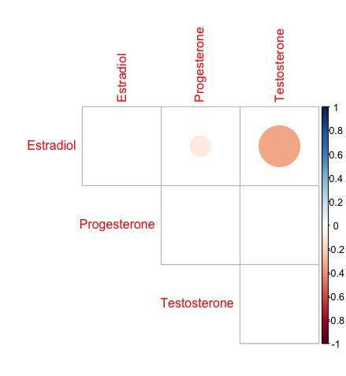
Are the three hormone chemicals related?
A correlation test was run between each chemical.

Slide 7
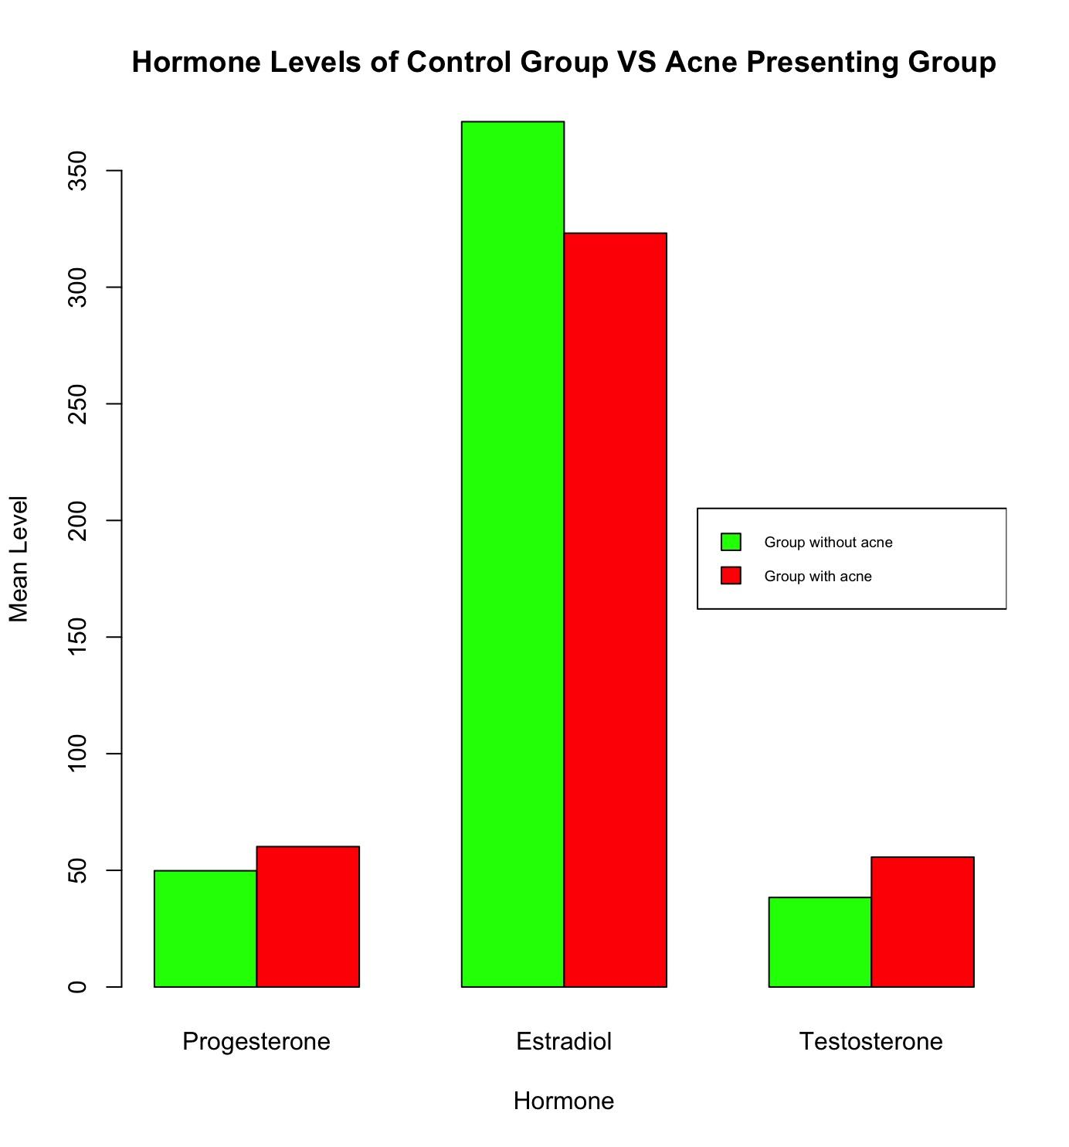
Did the mean level of any of the hormones differ in control group vs group with acne?

Slide 8
Are any of the three measured hormone chemicals a significant predictor of acne being present?
A logistic regression analysis was done on each hormone chemical and it was found that testosterone is a significant predictor of acne being present.
For every one unit increase in testosterone, the log odds of having acne increases by 0.06016

Slide 9
SUMMARY
The levels of testosterone and estradiol in women are slightly negatively correlated, meaning when one decreases the other one does as well.
The acne presenting group had a larger mean level of progesterone, smaller mean level of estradiol, and larger mean level of testosterone than the control group with no acne.
Logistic regression analysis showed that testosterone levels are a significant predictor of acne being present in women.

Slide 10
CONCLUSIONS
Acne affects a large percentage of women, 50%, and by nature is something women are willing to spend money and time on due to the affect it has on confidence.
Fortune Business Insights says that the acne treatment market size was USD 8.99 billion in 2021 and is projected to reach USD 12.97 billion by 2029.
With such a significant percentage of women being affected by acne and such a high amount of money being spent on treatment, the benefits to finding the cause of acne are endless for both people suffering from it and companies trying to efficiently treat it.

Slide 11
Questions?

